Slide 1



Exploring Best locations for Bakery store in Santiago, Chile
Applied Data Science Capstone
March 2021
Pedro Reyes O.

Slide 2
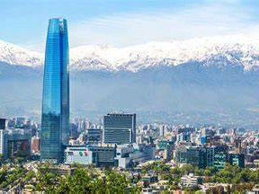
Introduction
Santiago de Chile, is the capital and largest city of Chile as well as one of the largest cities in the Americas. It is the center of Chile's most densely populated region, the Santiago Metropolitan Region, whose total population is 7 million, of which more than 6 million live in the city's continuous urban area.
Commercial activity is one of the drivers of economic growth and has generated many investors wanting to compete.
Location, location, location is the key for success

Slide 3
The Problem
Small investors and innovators want to explore specialized bakery chains whose requirements are for convenience and differentiating products
The locations must combine an adequate balance between the rental cost per square meter, that there are complementary attractive places and that there is a minimum volume of population residing in the vicinity

Slide 4
Target Audience Interest
• Business personnel who wants to invest or open a Bakery store
• People looking for profitable business alternatives with the possibility of self-employment
• Finding the best location for opening a commercial store
It is interesting to combine geographic analysis with data from commercial places valued by people and other data that could complement the analysis of localities.

Slide 5
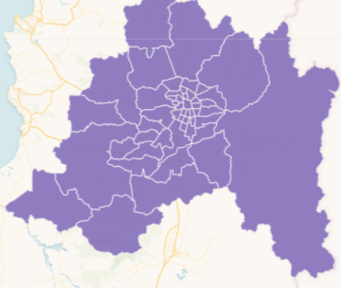
Data acquisition and cleaning
The following sources of information are identified that will be helpful in addressing the problem:
Latitude, longitude, Surface (km²), Population, 2020 Density (hab./km²) of districts in Santiago: https://es.wikipedia.org/wiki/Anexo:Comunas_de_Chile
Lease values ​​per square meter in districts in Santiago:
https://www.buenainversion.cl/blog/valor-metro-cuadrado/
Venues in Santiago:
https://api.foursquare.com/v2/venues/explore?&client_id={}&client_secret={}&v={}&ll={},{}&radius={}&limit={}’
GeoJson file for districts in Santiago:
https://cephei.carto.com/tables/comunas_santiago/public
The processes necessary to obtain the data and its preparation include:
web scrapping, direct loading, elimination of duplicates, homologate names of districts, join bases and normalize (standardize) the data before starting machine learning processes.

Slide 6
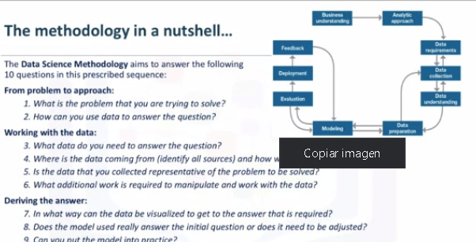
Methodology
Busines understanding defining the problem and its utility for the stakeholder
Data and processing.
Choose analytical approach: in this case the data will be explored through bar graphs, heat maps and choropleths.
Combining the data and normalizing it, an unsupervised learning technique will be applied to obtain clusters (Kmeans) and visualize them through folium.
The results will be presented graphically and tabularly with the necessary detail to be able to replicate them,
Finally, the conclusions and discussions will be analyzed, its scope and possible improvements will be seen.

Slide 7
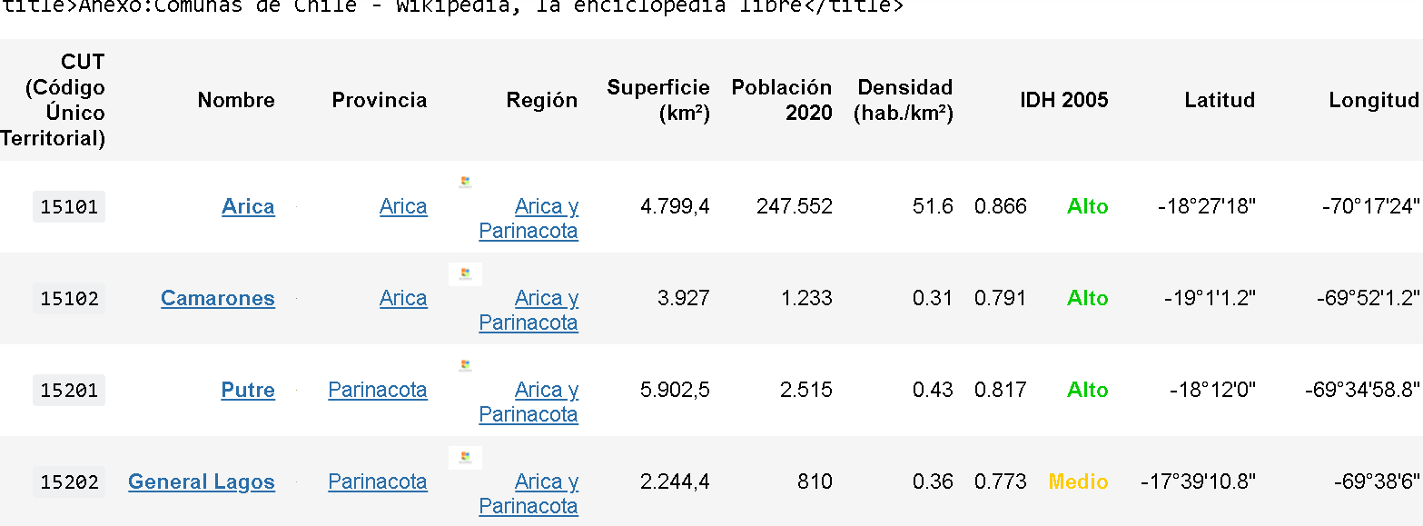
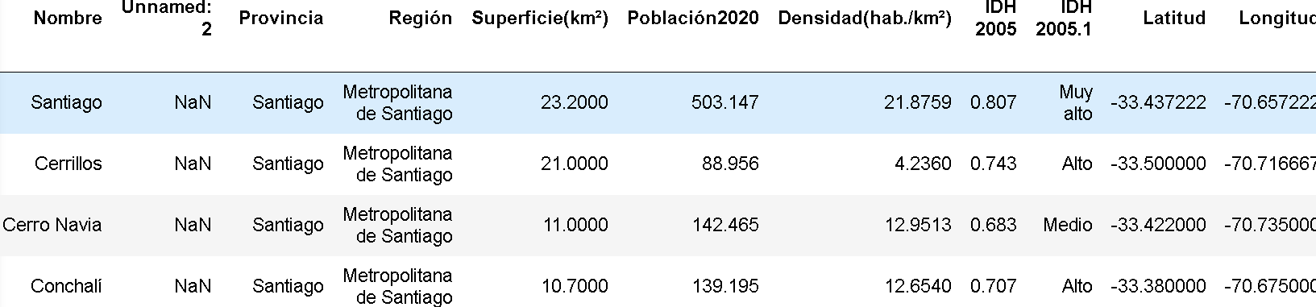
First views of data
Latitude y longitude must be to converted to decimals
Debugging processes: elimination of columns, null values, correct formats, etc.

Slide 8
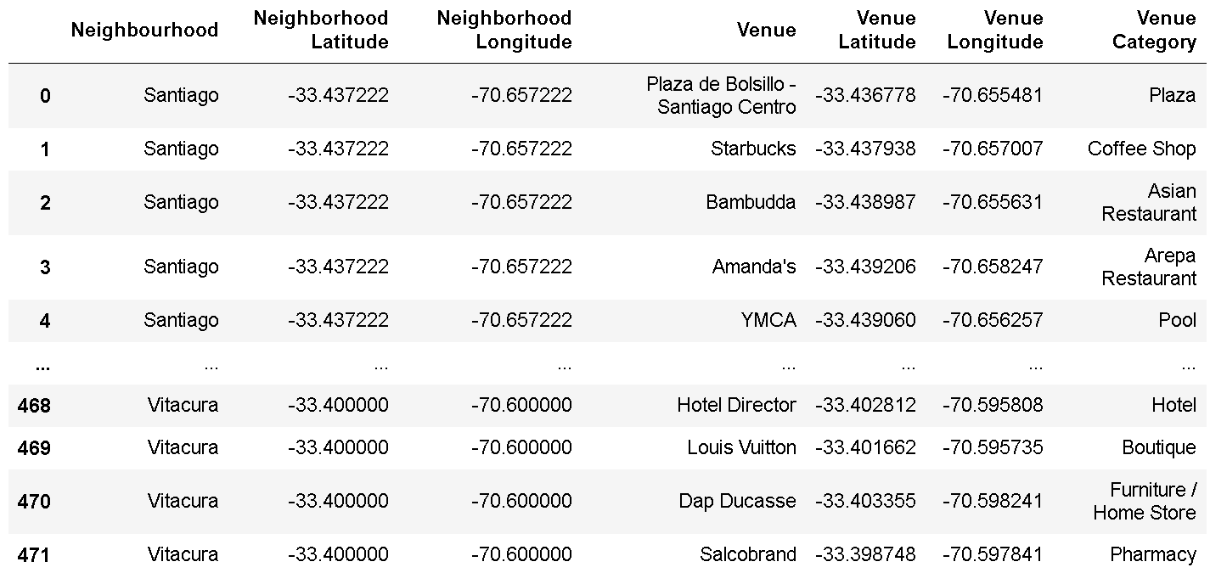
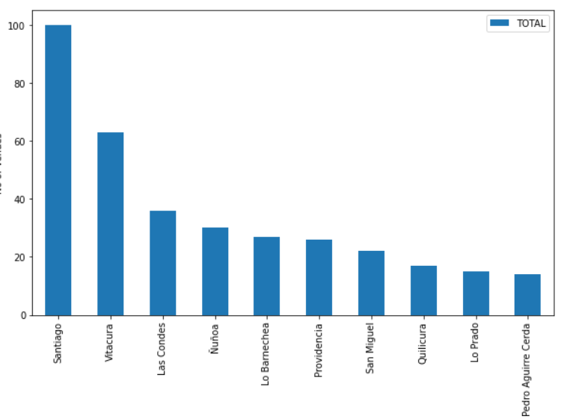
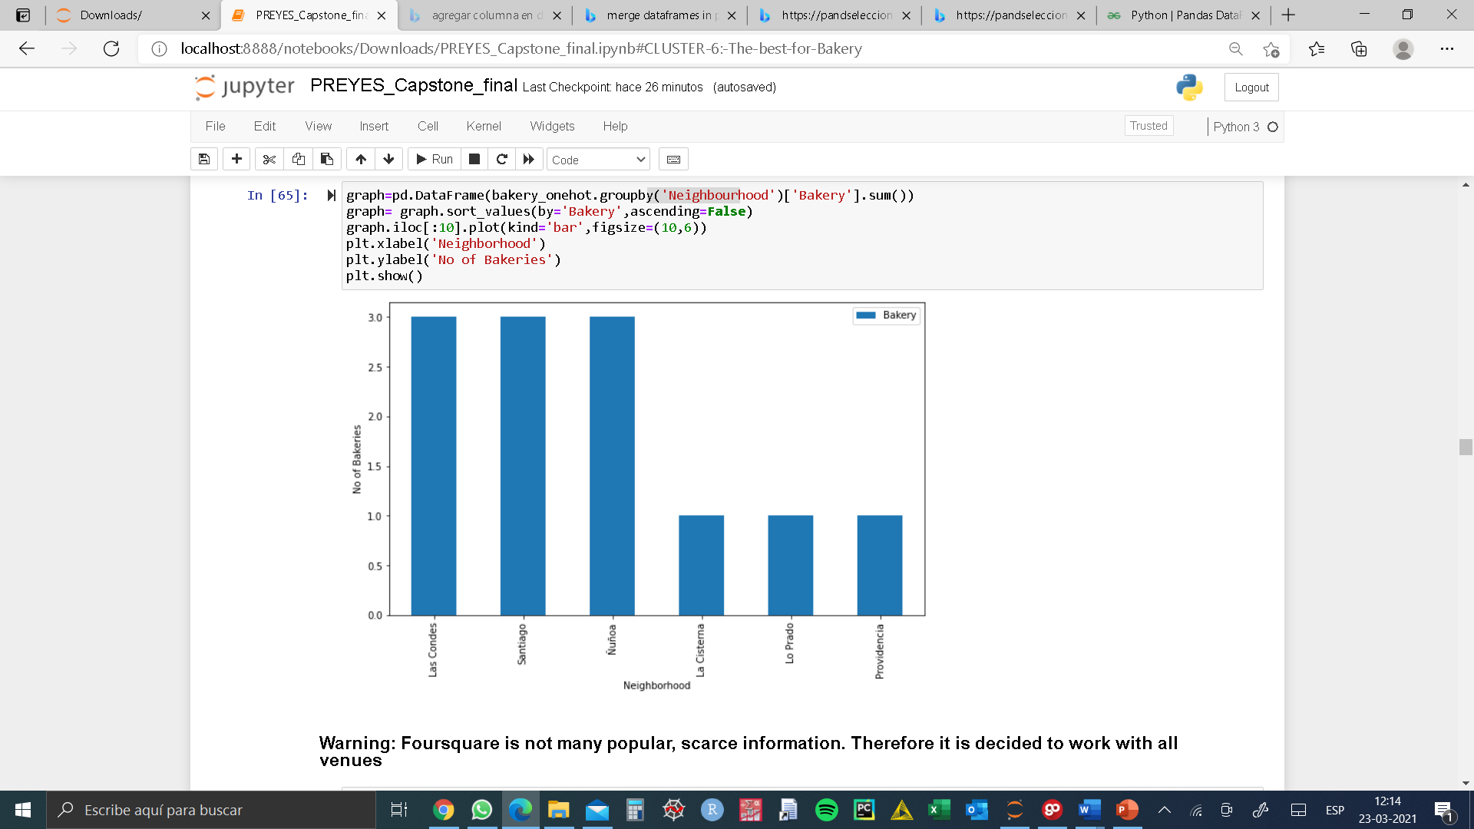
Looking at data from Foursquare
473 venues obtained
Only 12 venues in Bakery category
Only 7 districts has more than 20 venues
→ Work with ALL CATEGORIES and not only Bakery

Slide 9
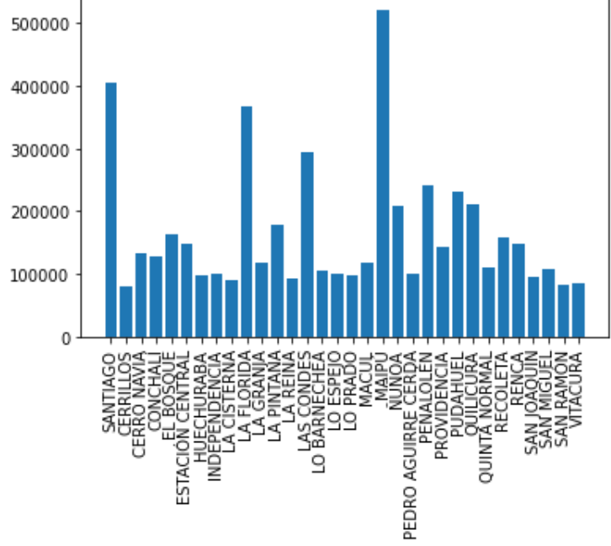
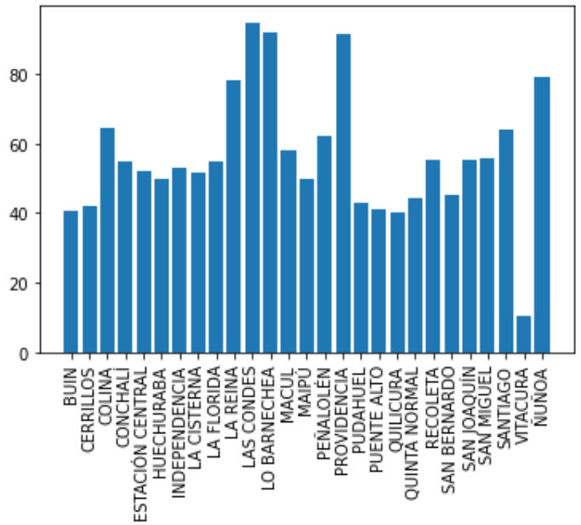
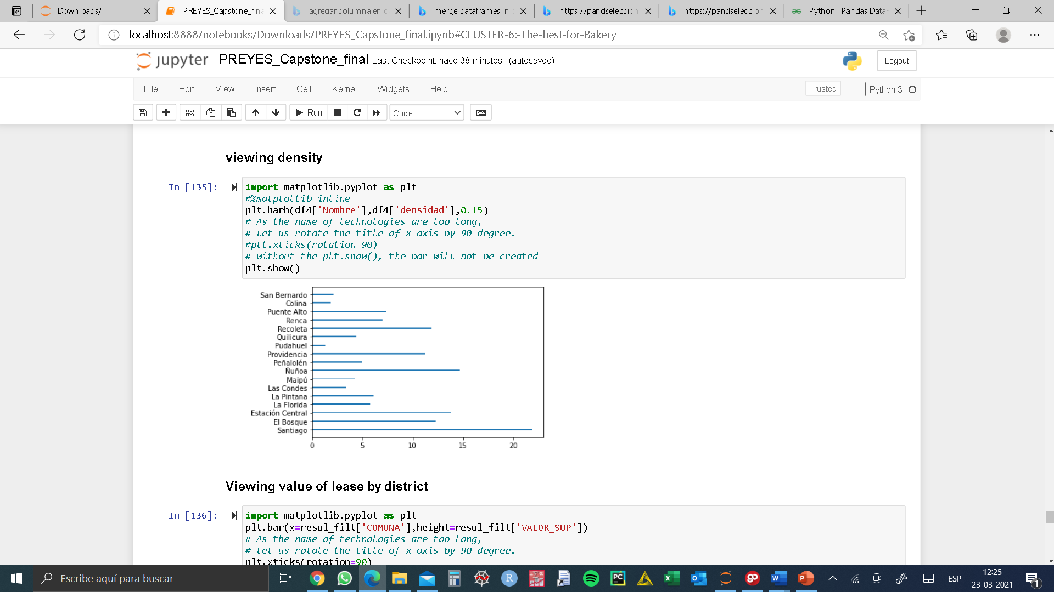
Exploring Polpulation, density and value of the land…
Population
Value UF/ m^2 lease
Density :Population / Km^2

Slide 10
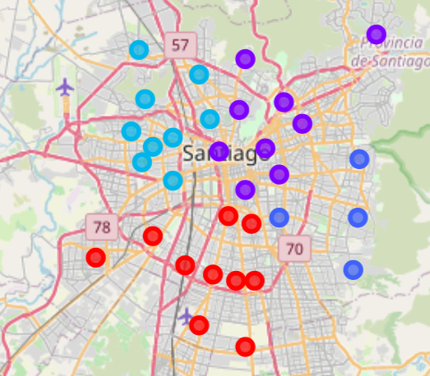
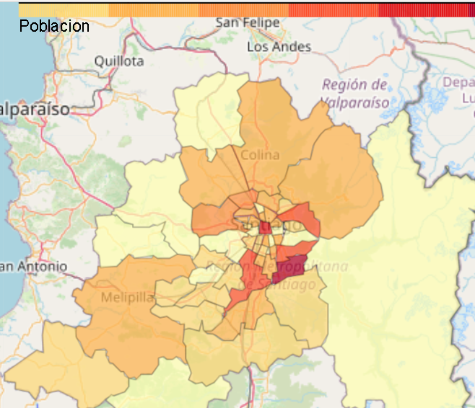
Putting the data in maps
Geographic clusters, K=4
Choropleth, population 2017
Use of folium library and GeoJson for choropleth maps

Slide 11
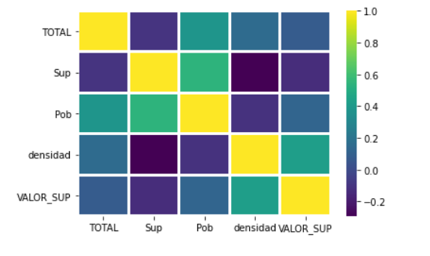
Correlation analysis
It is important to try to avoid correlated variables before starting the clustering process
Through this heat map we visualize the strongest and weakest correlations.
The one that stands out the most is the correlation between population and total number of venues extracted from Foursquare
Another interesting positive correlation is that of population density with the value of land use.

Slide 12
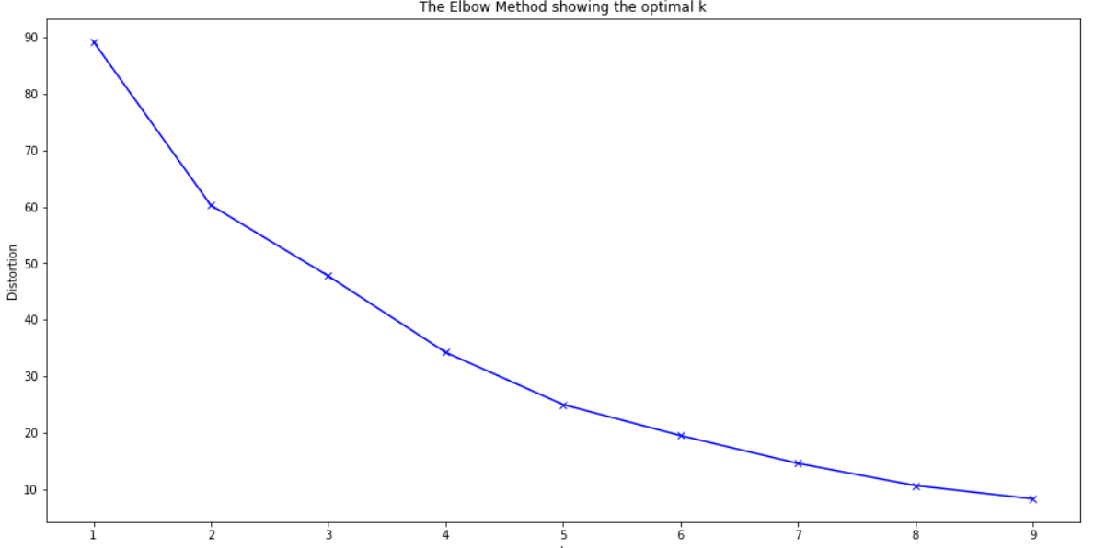
Machine learning technics
Clustering techniques vary depending on the bottom-up, top-down (hierarchical) approach, the distance measures used: Euclidean, Hamming (city block), Tchebyschev, Minkowski, Canberra, angular separation and the type of data used, which it can include fuzzy data sets. (Pedrycz, 2005).
For customer and market segmentation problems, the most used techniques are K-Means, C-Means and SOM (Self Organization Maps).
K-Means: one of the problems is its initial randomness at the starting point and the selection of number "k" of partitions. The elbow method calculates the total intra-cluster variance as a function of the number of clusters and chooses as optimal the value from which adding more clusters has marginal improvements.
Before executing the technique, the data must be standardized.
6 partitions will be used although the method suggests something else.
However, the criterion must also be functional to the problem and 6 it is considered that it meets the practical and with the elbow method

Slide 13
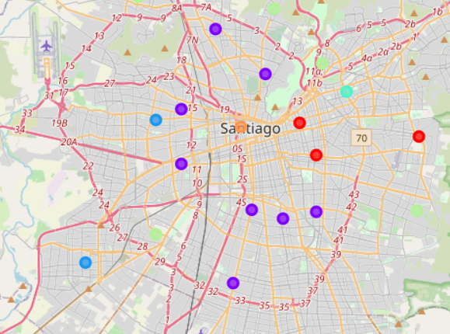
Results: Clustering
The clusters generated are no longer necessarily geographic.
The areas with the greatest potential are those in which there is a high concentration of people, high densities and moderate to high values of land costs, in addition to having greater places of interest.
The best area to start the exploration at the micro level is the cluster in the center of Santiago, where high density, high population, average values of land use and high commercial activity are combined (orange cluster).
It would be followed by the blue cluster with 8 districts that has as a characteristic a high population density.

Slide 14
Discussion and Conclusions
Despite being limited in time and information, it was possible to use the methodological approach.
The results effectively help people who want to know areas where to invest or start their own business.
However, at the micro level, there is work to be done. Foursquare is not very popular in Chile, which leads to underestimating the potential of certain areas. A possible improvement would be to supplement the data with more robust trade information.
Finally, the opportunity to carry out this applied project is appreciated

Slide 15
Exploring Best locations for Bakery store in Santiago, Chile
Applied Data Science Capstone
March 2021
Pedro Reyes O.
Code avaliable, in this link:
Segmenting-and-Clustering-Neighborhoods-in-Toronto/PREYES_Capstone_final.ipynb at master · preyes0/Segmenting-and-Clustering-Neighborhoods-in-Toronto (github.com)

